Slide 1


Personal Accident
Policy
Welcome!

Slide 2
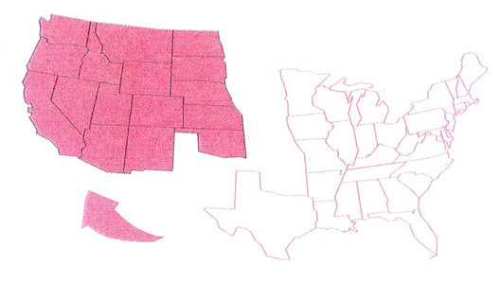
ACCIDENTS ARE A FACT OF LIFE!!
The National Safety Council states that
in just one year over 68 Million Americans
suffer accidental injuries…
That’s the equivalent of eve
That’s the equivalent of every man, woman, and child
now living in these shaded states.
Accidents happen and they happen often!
*Sources: National Safety Council’s Accident Fact Book, 1992. Business Control Atlas, 1992.
Does not imply endorsement

Slide 3
Lifesecure Accident Policy
That’s why we developed coverage for *most types of
Accidents …
Coverage for you and your family.
At home, at work, at school and at play, or any *non-professional sports activity!
24 hours a day!
Anywhere in the United States!!

Slide 4
Accident cause more than just
Medical short falls.
Some of the medical out-of-pocket expenses are:
Deductibles
Co-payments
Co-insurance
What about the out-of-pocket expenses most people don’t consider and medical won’t pay for.
Loss of income
Childcare
Carry out meals
The average Accident plan can barely help with the medical shortfalls and are very weak when come to outpatient accidents.
Here’s where we are different!!!

Slide 5
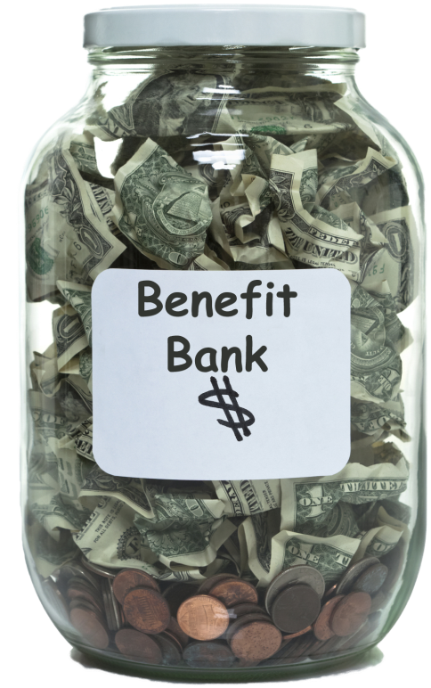
How does Personal Accident Insurance Work?
$15,000
Annual Benefit Bank
Per Year
Maximum $15,000 for Individuals
  $25,000 for Couples/Families
  (can be used by one or all members)
Annual Deductible
  $100
Notes:
HOW DOES PERSONAL ACCIDENT INSURANCE WORK?
Policy Holders have two decisions to make. There aren’t any confusing options, just one straightforward insurance plan.
CLICK
First, they select the Annual Benefit Bank amount. The Annual Benefit Bank represents the total dollar amount available for covered services rendered each calendar year. On January 1st of each year, the Annual Benefit Bank will restore to its full amount.
Policyholders can select any amount within the range, in $100 increments.
The Minimum is $2,500
The Maximum is $15,000 for individuals and $25,000 for couples and/or families. The money can be used by one or all members.
CLICK
Next they select the annual deductible. The Annual Deductible represents the dollar amount that an individual must incur in covered services in a calendar year before benefits are payable under the policy. Applicants can choose a $100, $250 or $500 deductible.
The deductible is known as a “disappearing deductible”. Let’s take a look at how that works.

Slide 6
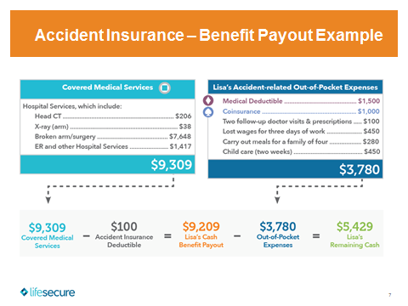

Total Personal Accident Benefit Payout: |  |  | $9,209
Notes:
PERSONAL ACCIDENT INSURANCE - FAMILY PAYOUT EXAMPLE
In one calendar year, each member of the family suffered an accidental injury,
CLICK
Dave’s wife Kim tripped over a log and sprained her ankle while jogging one morning in May. The deductible is $500.
Dave had cut his finger on a broken dish in the sink.
Their son Michael was accidentally hit in a soccer game and broke his nose.
CLICK
Their daughter Mandy broke her leg falling off her bike - but the family deductible has already been met, so there is no cost share for this accident.

Slide 7
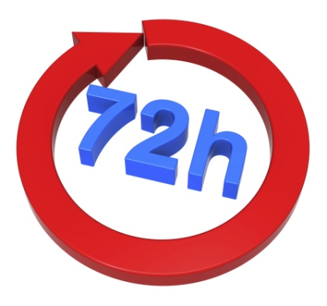

Important Time Limits
Initial care within 72 hours of accident
  Initial care must begin
Within 30 days of accident
  Major diagnostic exams must occur.
    One per accidental injury per covered family member.
    Two per year per covered family member.
All covered services EXCEPT Major Diagnostic Exams cover actual expenses, less any adjustments or discounts.
Major Diagnostic Exams are based on actual expenses
up to a maximum of $750 per exam.
Notes:
IMPORTANT TIME LIMITS
There are a few time limitations for covered services that are important to note.
CLICK
First, members must receive initial care within 72 hours of an accident and submit proof of claim for the actual medical and/or recovery expenses.
CLICK
Major Diagnostic Exams must be performed within 30 days of the accident in order to qualify for reimbursement. Major Diagnostic Exams are limited to one per accidental injury and a maximum of two Major Diagnostic Exams per year per covered member.
Major diagnostic exams covered by the policy are:
Computerized Tomography (CT)
Magnetic Resonance Imaging (MRI); or
Electroencephalogram (EEG)
CLICK
Benefit payout: To determine actual expenses, we will take into account adjustments or discounts, which may have been applied through providers or other payer organizations for services rendered. The benefit payout for Major Diagnostic Exams is based on actual expenses, up to a maximum of $750 per exam with a limit of two exams per calendar year/one per accident per covered member.

Slide 8


Important Time Limits
Within 90 days of accident:
  Surgery must occur
    Two per accidental injury per covered member
  Rehabilitative therapy must begin
    One per day per covered member. Up to 10 visits a year per accidental injury
Notes:
IMPORTANT TIME LIMITS
Other benefits provided are surgery and rehabilitative therapy, which both must begin within 90 days of the Accidental Injury.
Up to two surgeries are covered per accidental injury per covered person, and one rehabilitative therapy visit is covered per day per covered person (up to a maximum of 10 per year per accidental injury) in order to qualify for reimbursement.

Slide 9
HIGHLIGHTS
Benefits are paid directly to you in addition to any other insurance.
Guaranteed issue. No Underwriting!
Composite Rates!
Your policy is guaranteed renewable until age 75.
The premium rate does not increase with age and benefits do not decrease as you get older.
You can not be singled out for a rate increase! We can only change rates if we change rates on all policies of this type in your state.
Covers on and off the job accidents! Pays in addition to worker’s comp.
24/7 hours per day!
There is only a $100 deductible per year on individual plan.
Coverage is effective immediately once accepted by the company.
Pays off of E.O.B.-Much higher payout on claims!
You don’t need health insurance to buy this policy.

Slide 10
LIFESECURE ACCIDENT POLICY
The entire price for all this coverage is
Only….
Self Self & Spouse/Partner Self & Children Family
$32.74 $42.03 $50.29 $58.18
Can you see why so many people like yourself are taking advantage of this coverage?
It just makes good sense!

Slide 11
13 REASONS TO CONSIDER BUYING
LIFESECURE ACCIDENT POLICY!
Helps fill in gaps from high deductibles and co-insurance on Medical plans and helps to replace loss of income and other out of pocket expenses.
Guaranteed Issue-No underwriting.
Benefits pay in addition to any other insurance.
Health insurance not required. Can be sold stand alone.
On-the-job, off-the-job coverage. 24/7
Quick and easy online application with e-signatures.
Very affordable to both individuals and family’s.
Higher pay-outs in most cases than scheduled benefit plans.
Offered from18 to 74. Can be sold to seniors over 65!
Ideal for active families with children!
Simple pay with Visa/Master Card or EFT.
Composite Rates (Not age banded)
Available to both individuals and groups at the same rates.

Slide 12
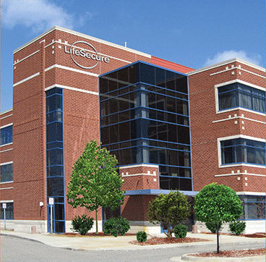
About LifeSecure
Founded in 2006.
A wholly-owned subsidiary of Blue Cross/Blue Shield of Michigan.
A financially strong insurance company with a constant focus on innovation and new technology solutions.
LifeSecure is currently licensed in 46 states + DC and growing. Product availability varies by state.
In 2014, LifeSecure was recognized as one of the fastest-growing LTC insurance companies.*
Current lines of business include Accident, Hospital Indemnity and Critical Illness.
*Source: U.S. Individual Long-Term Care Insurance Sales and In Force Survey, LIMRA, 2014
Notes:
Pure online application with VAC or e-signature
Personal agent, group, & policy holder portals with 24/7 access
Budget point pricing tool for LTC (monthly budget) – What can the client afford? $50, $75, $100 a month?
LifeSecure’s outstanding Personal Accident
Insurance program filed in Michigan in 2011
and approved to market on October 1st

